Slide 1

ASP.NET MVC 4 Developer Preview
Jon Galloway
SoCal Code Camp

Slide 2
Agenda
Overall focus areas for ASP.NET MVC 4
Installation overview and availability
Top new features

Slide 3
Overall focus areas for ASP.NET MVC 4
Goal: Make ASP.NET MVC the best web platform for building modern rich web apps
Themes
Development and deployment Capitalize on the platform
The Razor view engine and some of the new helpers in ASP.NET MVC 3 came out of work done for ASP.NET Web Pages.
Ajax
“Dash of Ajax”
Full single-page application
HTML5, tablet, and mobile
Cloud ready

Slide 4
Notable Breaking Changes
There are issues when running ASP.NET MVC 3, ASP.NET MVC 4, and Windows Azure Tools for Visual Studio 2010 1.5 side by side.
Installing ASP.NET MVC 4 Developer Preview breaks ASP.NET MVC 3 RTM (but not the ASP.NET MVC 3 Tool Update) applications.
Workarounds detailed in release notes.

Slide 5
Requirements
ASP.NET MVC 4: .NET Framework 4
Tooling:
Visual Studio 2010 with Service Pack 1 or
Visual Web Developer Express 2010 with SP1

Slide 6
Major Features in MVC 4
Enhancements to Default Project Templates
Display Modes
jQuery Mobile, the View Switcher, and Browser Overriding
Mobile Project Template
Recipes for Code Generation in Visual Studio
Task Support for Asynchronous Controllers

Slide 7
Default Template Changes
New Design
Adaptive Rendering

Slide 8
Custom Modes
DisplayModes.Modes.Insert(0, new DefaultDisplayMode("iPhone")
{
ContextCondition = (context => context.Request.UserAgent.IndexOf
("iPhone", StringComparison.OrdinalIgnoreCase) >= 0)
});
Views\Shared\_Layout.iPhone.cshtml

Slide 9
Major Features in MVC 4
Enhancements to Default Project Templates
Display Modes
jQuery Mobile, the View Switcher, and Browser Overriding
Mobile Project Template
Recipes for Code Generation in Visual Studio
Task Support for Asynchronous Controllers

Slide 10
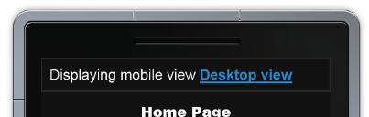
jQuery Mobile – Browser Switcher
<body>
@Html.Partial("_ViewSwitcher")

Slide 11
Recipes
Modular tooling installed via NuGet

Slide 12
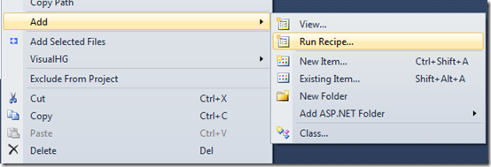

Slide 13
Async Support
[AsyncTimeout(2500)]
[HandleError(ExceptionType = typeof(TaskCanceledException), View = "TimedOut")]
public async Task<ActionResult> Index(string city,
CancellationToken cancellationToken) {
var newsService = new NewsService();
var sportsService = new SportsService();
return View("Common",
new PortalViewModel {
NewsHeadlines = await newsService.GetHeadlinesAsync(cancellationToken),
SportsScores = await sportsService.GetScoresAsync(cancellationToken)
});
}

Slide 14
Async Support
[AsyncTimeout(2500)]
[HandleError(ExceptionType = typeof(TaskCanceledException), View = "TimedOut")]
public async Task<ActionResult> Index(string city,
CancellationToken cancellationToken) {
var newsService = new NewsService();
var sportsService = new SportsService();
return View("Common",
new PortalViewModel {
NewsHeadlines = await newsService.GetHeadlinesAsync(cancellationToken),
SportsScores = await sportsService.GetScoresAsync(cancellationToken)
});
}

Slide 15
Other Goodies
Spec: http://aspwiki/MVC_v4_Spec.ashx
Other Features (listed in public roadmap)
We haven’t spent time fleshing out every feature under consideration. The following items are on the top of our mind. Some of them will be delivered by other teams.
CSS and JavaScript Bundling Integration ASP.NET MVC 4 will include CSS and JavaScript bundling. Bundling consolidates .css and .js files by combining multiple files into a single file and reduces the total size of the resulting (combined) file by removing unnecessary whitespace and comments (minification). This reduces both bandwidth usage and download times, which speeds up the rendering of web pages.
EF Code First Data Migrations. This provides support for migrating from one version of your database schema to the next without losing data.
Better support for functional and integration testing of application code.
WCF Web API support.
Ajax improvements across the board. We’re focusing reducing the friction that developers encounter when using Ajax with ASP.NET MVC.
HTML5 support for editor/display templates and HTML helpers. For example, editor templates to might render an input element with its type set to date instead of an input element with its type set to the default text when rendering a DateTime property. Likewise, existing HTML helpers such as TextBoxFor might also be updated to render an appropriate input element based on the model type.
Support for “donut hole” caching in Razor views and support for the Windows Server App Fabric caching provider.
A new AreaAttribute class for better security when using areas.

